Slide 1
Single-Player GenCyber Card Game

Slide 2
Learning Objectives
Understand the 10 Cyber Security First Principles.
Be able to identify specific Cyber Security First Principle for each question card.

Slide 3
10 Cyber Security First Principles
Domain Separation
PC operating environment has a system domain and a user domain. In system domain, privileged hardware instructions can be executed, for example, access memory for a running application. A user domain, however, can only send request to the access memory (may be granted, may be denied).
Process Isolation
In your computer, the word processor cannot access the memory of the web browser. When your word program crash, your web browser still runs well.
Resource Encapsulation
Various hardware devices such as hard disks, USB drives, network folders are encapsulated into "Drive“
Encapsulation is also an object oriented concept where all data and functions required to use the resource are packaged into a single self-contained component.
Least Privilege
The principle of least privilege says to allow the minimum number of privileges necessary to accomplish the task.
You are given a regular user account at PNW, you cannot install Operating system files and applications. Because you just need to use applications, and no need to manage applications and OS.

Slide 4
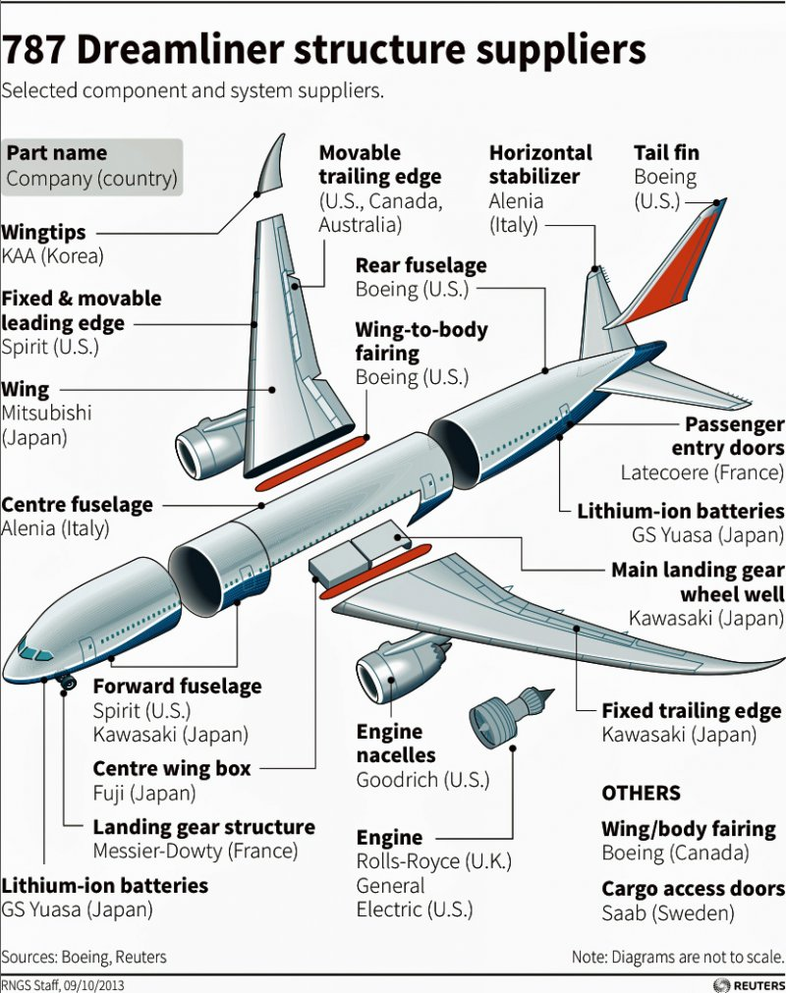
10 Cyber Security First Principles
Modularity
Modular programming is a software design technique that emphasizes separating the functionality of a program into independent, interchangeable modules. Each module contains everything necessary to execute a unique part of the desired functionality through well designed interfaces. These well-defined interfaces provide all the detail needed for one module to replace another and achieve the needed results.
Layering
Layering in computer security implements multiple layers of computer security, each one having to be conquered before moving to the next.
Email Security: File attachment virus scan, Email Server Anti-Virus and Filtering(Phishing, Scam), PC AntiVirus
Firewall, IT Policy (Port Scanning, Remote Login), System Update, Anti-Virus, Hard Drive Encryption
Abstraction
Abstraction is about only providing the necessary details, and hiding all the “clutter” and reducing the details to a set of essential characteristics.
Battery Level, Wi-Fi Strength, etc

Slide 5
10 Cyber Security First Principles
Data Hiding/Information Hiding
Data and information hiding keeps the programmer from having complete access to data structures. It allows access to only what is necessary.
Encryption of data packet
Simplicity
Allows a person to better understand essential function, by removing unnecessarily complicated code and interfaces.
A design principle at Apple, especially with the iPhone.
Minimization
The goal of minimization is to decrease the number of ways that software can be exploited.
As software increases in size, the ability to secure the program becomes more difficult due to increased size and complexity of the software.

Slide 6
Discussion
What Question card you have difficulties to match with Principle card?
What Principle you have difficulties to understand?

