Slide 1
3D Secure Cyber and Online Behavior Game

Slide 2
Learning Objectives
Understand the appropriate cyber and online behavior
Be able to identify the phishing email and legitimate email.
Be able to know how to handle phishing emails.
Be better aware of phony phone calls and developing countermeasures.
Be able to know how to protect personal information.

Slide 3
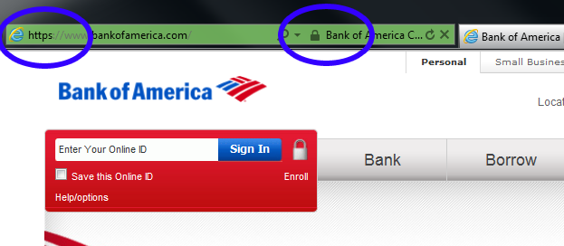
Secure online behaviors
Phishing email: An attempt to obtain sensitive personal information such as usernames, passwords, and credit card details, by disguising as a trustworthy entity in an email.
the annual worldwide impact of phishing could be as high as US$5 billion
Text Messages (Smishing): basically phishing scams that are sent over Short Message Service (SMS) text messages.
Trustworthy/Secure Website:
Look for a secure connection protocol HTTPS://
A lock icon in the address bar also indicates a more secure connection, which makes it harder for a hacker to view the information that you type.
Look at the Domain name:
Limited: .edu, .gov, .int, .mil
Open: .com, .org, .net
10 most suspicious Top-Level Domain list: .zip, .review, .country, .kim, .cricket, .science, .work, .party, .gq, .link
95 percent of the sites associated with these TLDs had been flagged for suspicious activities, such as spam, scam, potentially unwanted software, malware, botnet and/or phishing
Identify public v.s. secure Wi-Fi
Strong Password
AntiVirus, System Udate

Slide 4
Discussion
What is the risk and consequence of mishandling phishing emails?
What is the risk of mishandling text messages, phony phone calls, and fake website?
What is the risk of releasing your personal information?

